Slide 1
HOW COVID HAS AFFECTED PEOPLE’S FOOD HABITS

Slide 2
PEOPLE'S NUTRITIONAL HABITS IN GENERAL HAVE CHANGED DURING THE COVID PERIOD

Slide 3
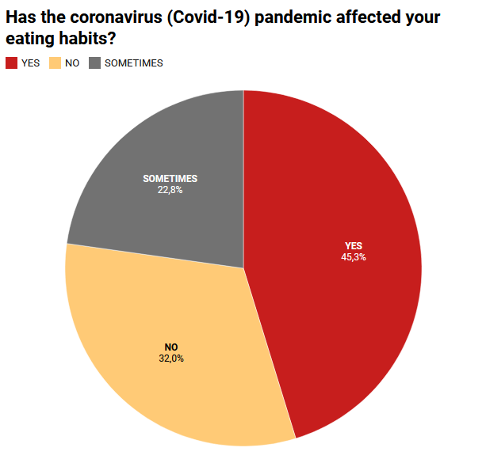

Slide 4
ALSO, PEOPLE'S BUDGETS HAVE BEEN AFFECTED DUE TO FOOD EXPENDITURES DURING THE COVID PERIOD.

Slide 5
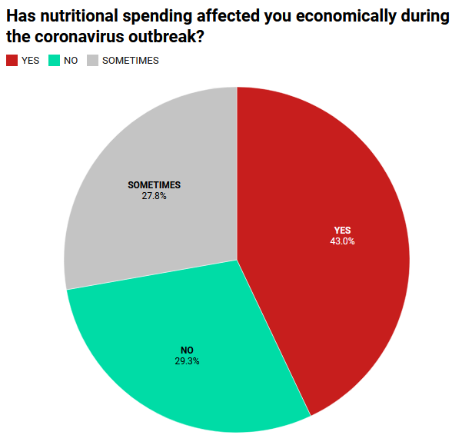

Slide 6
THE TYPES OF FOOD PEOPLE CONSUME IN THE COVID PERIOD HAVE ALSO CHANGED.

Slide 7
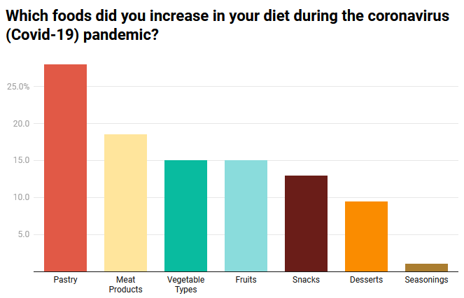

Slide 8
THE NUMBER OF MEALS PEOPLE CONSUME DURING THE DAY HAS CHANGED.

Slide 9
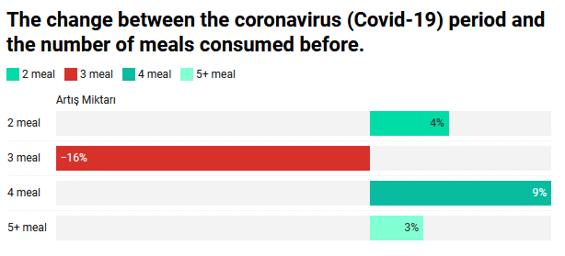

Slide 10
THEREFORE, CHANGES HAVE OCCURRED IN PEOPLE'S BODY WEIGHTS.

Slide 11
